Slide 1
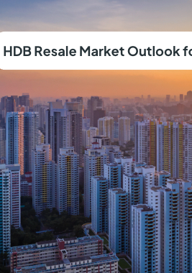
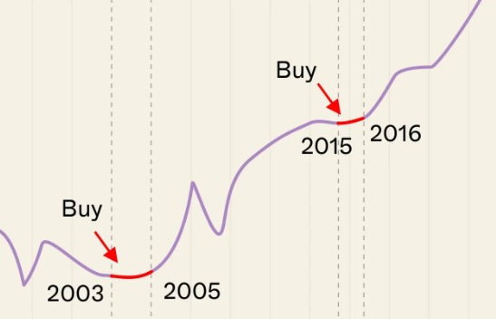
HDB resale STATISTICS
SCTP CAPSTONE 1 BY LIEW KOK HONG

Slide 2


agenda
Description of Dataset
Data Transformation
Analysis & Report Creation using Power BI
Dashboard
Insights
Future Scope

Slide 3


Description of dataset
The main data set used in the capstone is the hdb_resale_flat sources from data.gov.sg. It mainly consist of Resale transacted prices for Mar 2012 to Jun 2019, the data is based on date of registration for the resale transactions and includes the flat model, flat type, remaining lease, units’ floor area, storey and location.
Description | Resale Transaction
Origins of Data | Data.gov.sg (Resale Flat Prices)
Data size | 141668 entries
Format | .csv
Content | HDB resale transaction from Mar 2012 to Jun 2019
Task | To review and analyse past transactions to propose future market position.

Slide 4


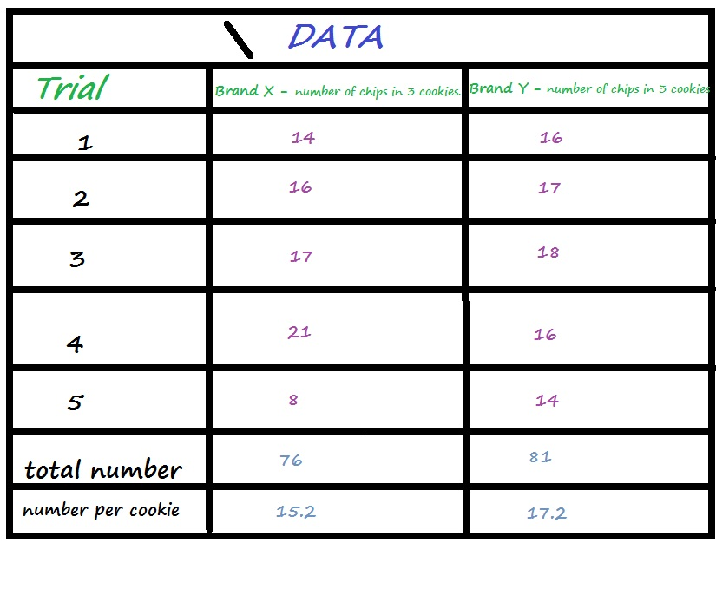
Data Transformation
Review Columns Quality
Renamed Columns
Changed Columns Type
Fill in empty cells and adjust dates entry format
Added new remaining lease term column based on HDB max 99 years lease
This Photo by Unknown Author is licensed under CC BY-SA-NC
This Photo by Unknown Author is licensed under CC BY-SA-NC

Slide 5
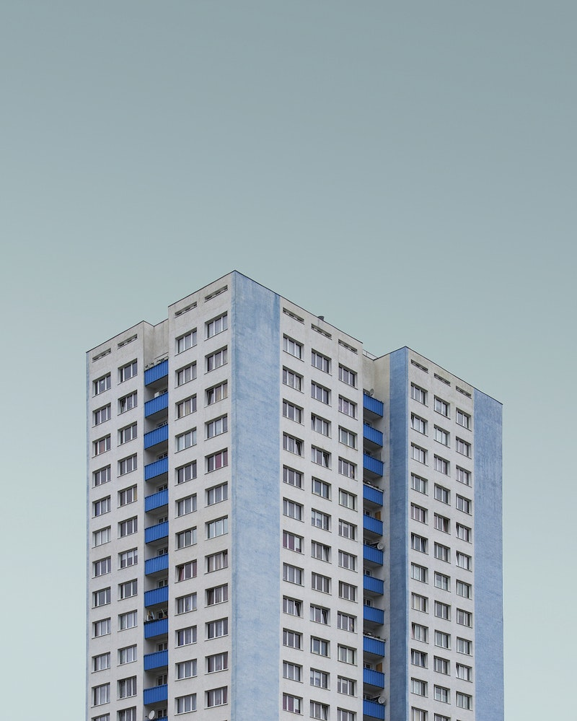
Analysis & Report Creation using Power BI
Types of HDB units in Singapore.
Top 3 most popular Flat Type.
Top 5 most popular District.
Factors driving the Increase / decrease valuation of re-sale units.

Slide 6
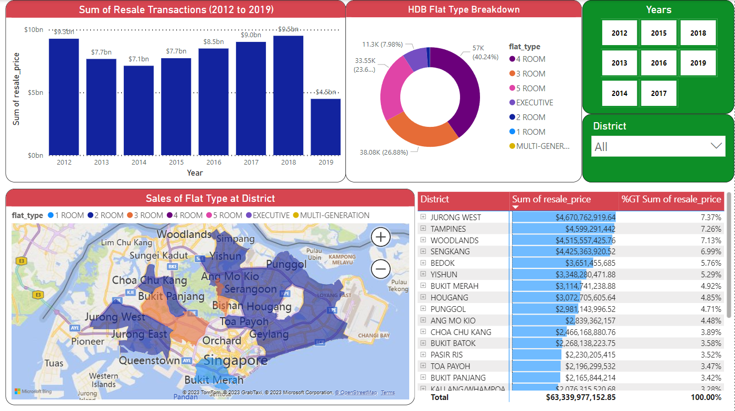

Slide 7
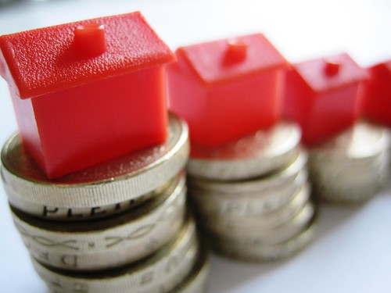
Types of HDB units in Singapore
TOP 3 MOST POPULAR FLAT TYPE
TOP 5 MOST POPULAR DISTRICT
1 ROOM
2 ROOMS
3 ROOMS
4 ROOMS
5 ROOMS
EXECUTIVE
MULTI-GENERATION
3 ROOMS
4 ROOMS
5 ROOMS
JURONG WEST
WOODLANDS
TAMPINES
SENGKANG
YISHUN

Slide 8
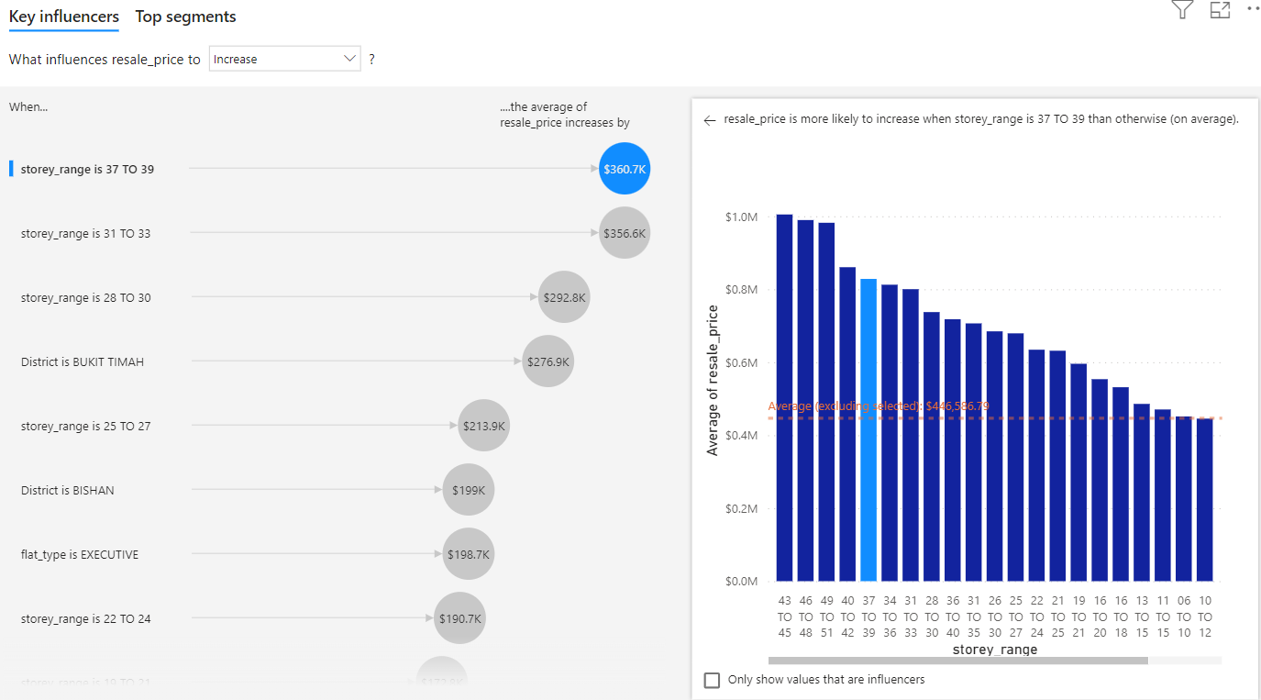
Factors driving the Increase valuation of re-sale units.
UNITS’ STOREY OR FLOOR LEVEL (MOST SIGNIFICANT INCREASE ON UNITS AT HIGHER FLOORS)
MARKET TREND ON AVERAGE HIGHER INCREASE IN RE-SALE PRICE IN BUKIT TIMAH, BISHAN DISTRICT
EXECUTIVE & 5 ROOMS UNIT TYPE HAVE ON AVERAGE HIGHER INCREASE RE-SALE VALUE

Slide 9
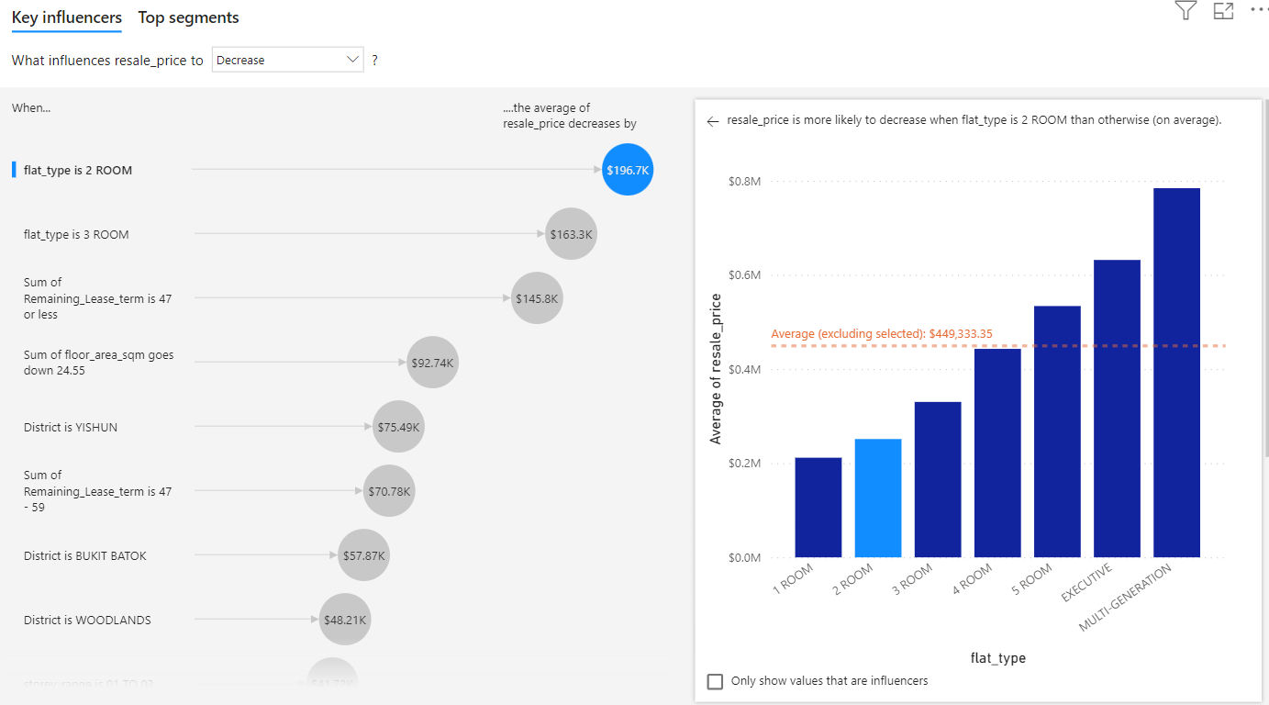
Factors driving the DECREASE valuation of re-sale units.
SMALLER UNITS / FLOOR AREA (2 ROOMS, 3 ROOMS FLAT)
SUM OF REMAINING LEASE TERM IS 47 OR LESS (BASED ON MAX 99 YEARS LEASE OF HDB UNITS)

Slide 10

insights
Sum of resale_price trended down, resulting in a 51.65% decrease between 2012 and 2019.﻿﻿ ﻿﻿
﻿﻿Sum of resale_price started trending up on 2015, rising by 23.12% ($1,786,912,634.99) in 3 years.﻿﻿ ﻿﻿
﻿﻿Sum of resale_price jumped from $7,729,135,940.52 to $9,516,048,575.51 during its steepest incline between 2015 and 2018.﻿﻿ ﻿
4 ROOM accounted for 40.24% of Count of block.﻿﻿ ﻿

Slide 11

Future scope
The HDB market trend is constantly evolving, based on the most recent National Day Rally speech in 2023 a new classification of flats were introduction where towns will no longer be demarcated as mature and non-matured.
Coming 2024, Tighter Restrictions will also be implemented such as the 10 years MOP (Min Occupation Period) which is the time period ‘New’ HDB owners are required to occupy their flat before they can sell it on open market.
Such changes and announcements will have an impact on the valuation of HDB re-sale market trend on top of the fundamental and Key impacts related to the flats’ location, floor area, units’ storey and remaining lease term.

Slide 12



